Slide 1
Introduction to Microsoft Azure App Service (Logic and API Apps)
Lightning Talk
Sandro Pereira
Senior Software Developer
Microsoft Integration MVP

Slide 2
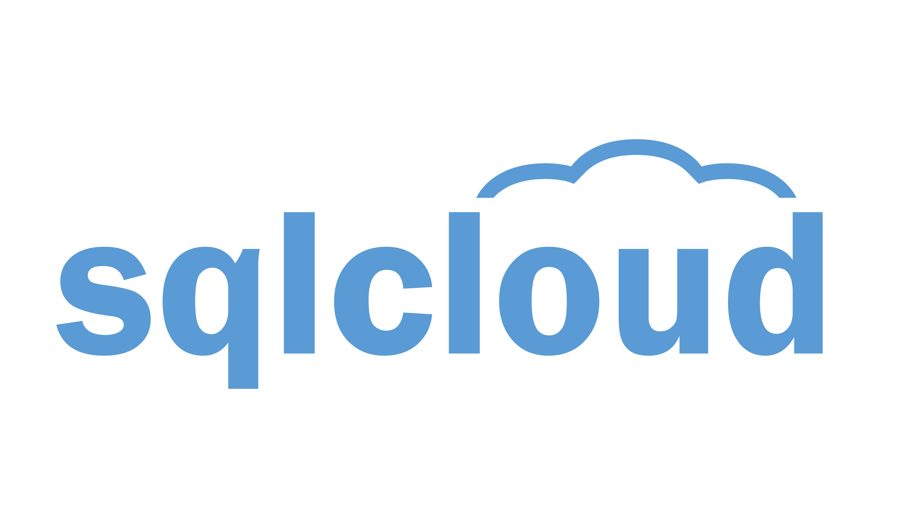


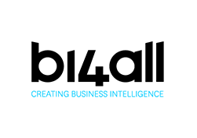



Our Main Sponsors:

Slide 3
Say Thank you to Volunteers:
They spend their FREE time to give you this event.
Because they are crazy. ☺
Because they want YOU to learn from the BEST IN THE WORLD.

Slide 4


Sponsor Sessions at 15:25
Don’t miss them, they might be getting distributing some awesome prizes!

Slide 5


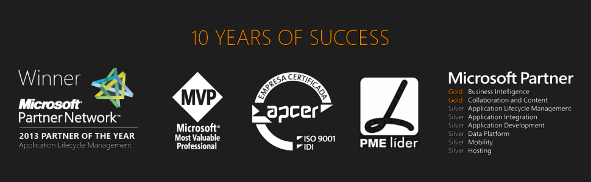



Hello SQLSaturday#429 Porto!
Sandro Pereira
Senior Software Developer | Microsoft Integration MVP
sandro.pereira@devscope.net
linkedin.com/in/sandropereira
@sandro_asp
sandroaspbiztalkblog.wordpress.com
+351 223 751 350
www.devscope.net
Notes:
My name is Sandro Pereira and I’m working as a BizTalk Consultant at DevScope in Portugal an amazing company and I’m a Microsoft Integration MVP since 2011

Slide 6

Agenda
Integration Challenges
Introduction to Microsoft Azure App Service
Logic Apps
API Apps
Demo

Slide 7

OVERWHELMED?
CHALLENGES
Inconsistent
Information
Two many Systems
Incompatible Systems
Different data formats
Massive Number of endpoints
Inefficient Processes
Long running operations
Need to Scale
Lacks Visibility
Different protocols
fault tolerant
monitoring and management
retry mechanisms, persistence, backup channels
ALWAYS ON
Notes:
Source: https://www.flickr.com/photos/andresthor/3963368371/

Slide 8


Microsoft BizTalk Server
RFI
Microsoft BizTalk Server 2013 R2
Suppliers Web Service
Inventory Application
IT Pros and Developers
EDI RosettaNet
Business
Users
Business Partners Chain System
Enterprise Resource Planning (ERP) Application
SQL Server 2014
Oracle EBS 11.5
on premise “king” platform integration

Slide 9

Azure App Service
Unique integrated offering
Build rich, engaging & intelligent apps
Scale as your business grows
Azure Websites
Mobile Services
BizTalk Services
Key app services in Azure today

Slide 10

One integrated offering
Web Apps
Mobile Apps
Web apps that scale with your business
Build Mobile apps for any device
LOGIC Apps
Api Apps
Automate business process across SaaS and on-premises
Easily build and consume APIs in the cloud

Slide 11
Logic Apps for easy automation
Browser based “workflow” engine
No code designer for rapid creation
Dozens of pre-built templates to get started
Out of box support for popular SaaS and on-premises apps - pre-built connectors
Use with custom API apps of your own
Biztalk APIs for expert integration scenarios
Provides in-built support for tracking
LOGIC Apps
Automate SaaS and
on-premises systems

Slide 12
Easily use cloud or custom APIs:
Dozens of built-in APIs for popular SaaS
An ecosystem of APIs for any need
Create and publish custom, reusable APIs
Visual Studio tooling with one click publish and remote debugging
Automatic client SDK generation for many languages
Api Apps
Create, consume and
host APIs more easily

Slide 13
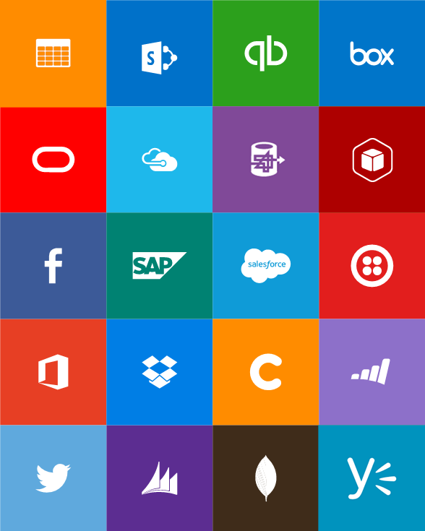
Built-in API Connectors
Connectors
Box
Chatter
Delay
Dropbox
Azure HD Insight
Marketo
Azure Media Services
OneDrive
SharePoint
SQL Server
Office 365
Oracle
QuickBooks
SalesForce
Sugar CRM
SAP
Azure Service Bus
Azure Storage
Timer / Recurrence
Twilio
Twitter
IBM DB2
Informix
Websphere MQ
Azure Web Jobs
Yammer
Dynamics CRM
Dynamics AX
Hybrid Connectivity
Protocols
BizTalk Services
HTTP, HTTPS
File
Flat File
FTP, SFTP
POP3/IMAP
SMTP
SOAP + WCF
Batching / Debatching
Validate
Extract (XPath)
Transform (+Mapper)
Convert (XML-JSON)
Convert (XML-FF)
X12
EDIFACT
AS2
TPMOM
Rules Engine

Slide 14
How BizTalk fits in Azure APP Services
basic features comparison
BRE
Pipelines
Orchestrations
Maps
Adapters
Api Apps
LOGIC Apps
Easily build and consume APIs in the cloud
Automate business process across SaaS and on-premises

Slide 15
DEMO

Slide 16
Thanks
sandro.pereira@devscope.net
linkedin.com/in/sandropereira
@sandro_asp
sandroaspbiztalkblog.wordpress.com
+351 223 751 350
www.devscope.net

